Slide 1
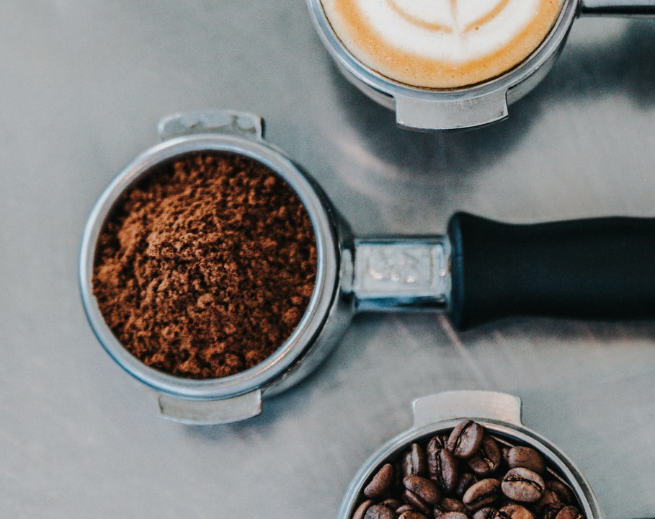
IBM CAPSTONE PROJECT – DS Entering the coffee shop market in Jakarta, Indonesia
By: Ega Kurnia Yazid

Slide 2
Background
Indonesia is one of the world largest coffee exporters and drinking coffee has been Indonesian morning mantra for centuries. Therefore, considering Indonesia potential as the home of many coffee varieties; then, bringing Indonesia coffee culture a step further will be a great movement for the industry. Moreover, on-the-go delivery coffee or beverages is becoming a new hype these days. Utilizing these opportunities, then opening a new coffee shop at the right time will be really challenging. Then, it is important to be careful to pick a strategic location to open a new coffee shop.

Slide 3

Business Problem
This report aims to figure out the best location to enter the coffee market in Jakarta, Indonesia. Using data science and machine learning capacities such as clustering, this project will answer the less coffee shop district around Jakarta, so that it will be less competitive to enter the coffee shop market.

Slide 4
Data
List of neighborhoods (districts) in Jakarta, Indonesian capital city [Wikipedia]
Latitude and longitude data that showing the coordinate of its neighborhood [Geocoder]
Venue data which informs the nearby venue around the neighborhoods [Foursquare API]

Slide 5
Methodology
Clustering
K-Means Clustering
Analysis

Slide 6
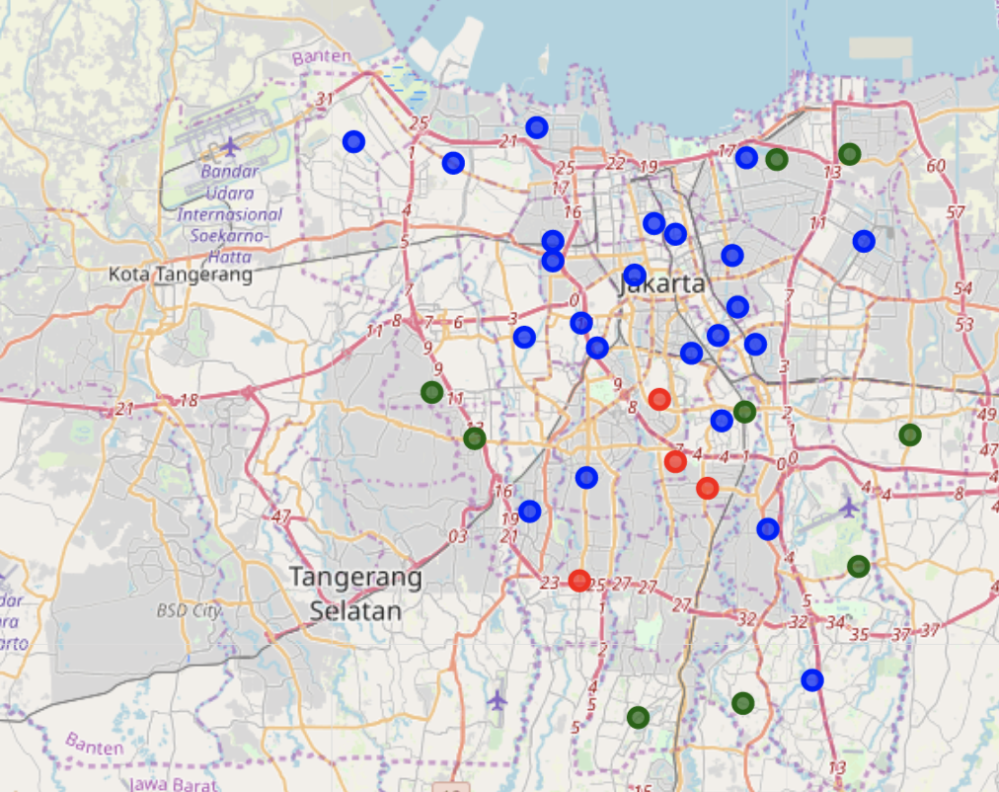
Results
Cluster 0 is a cluster that contain some coffee shops.
Cluster 1 is a cluster that contain less coffee shops, where relatively located at uptown.
Cluster 2 is a cluster with the highest coffeeshop density.

Slide 7
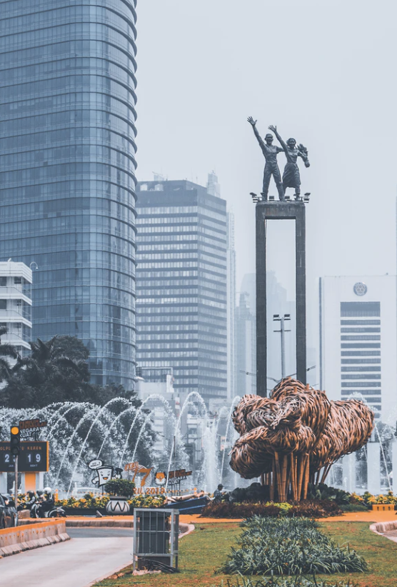
CONCLUSION
Uptown Coffeeshop
To conclude, after applying coffeeshop clustering, then the data has shown that the least coffeeshop density is located around outer ring of Jakarta, where mostly a residential place. Therefore, building a coffeeshop around it will be an advantage because it will be less competitive. Along with it, the coffee shop will be interesting if they can focus on residential market, and they can boost their promo at night or on the weekend.

